Slide 1


SUPpORTING adolescents who are deaf or hard of hearing IN Transition TO POST-SCHOOL EDUCATION & EMPLOYMENT
A narrated PowerPoint for careers personnel
September 2015
Part 3
Renée Punch PhD

Slide 2

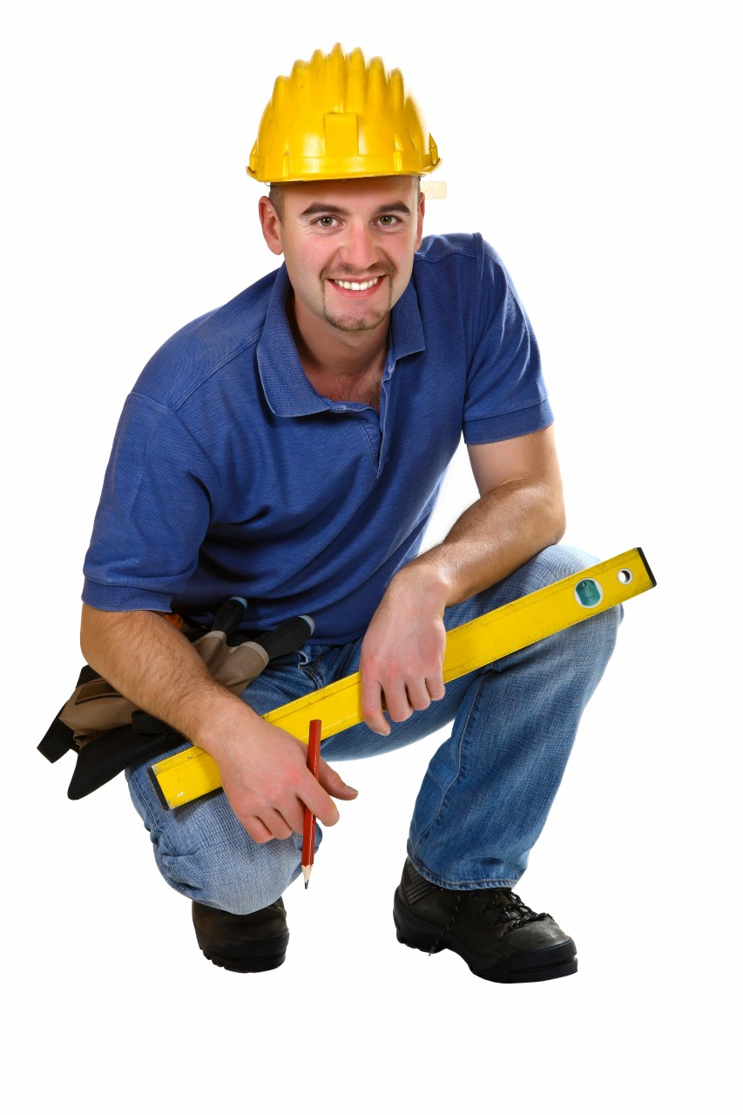
Part 3 Focus on employment
Notes:
It’s important not to have limited expectations of the sorts of occupations students who are D/HH should aspire to. At the same time, we need to understand the challenges they are likely to face and help them to be best prepared to deal with them when they arise.

Slide 3
Can he/she do that job?
Start by assuming ‘yes’
May be some limitations but possible with latest technology/ accommodations
Set task of internet research – occupation, technological solutions
Notes:
Sometimes students are unsure if their hearing loss will preclude them from entering particular occupations or doing certain jobs that interest them. Can I be a doctor? A nurse? Could I work on building sites? Could I be a teacher? Work in childcare? Parents and teachers often aren’t sure either.
In most cases I’d advise to start by assuming that it’s possible, and doing some research to find out more about it. While genuine barriers may exist to employment in some occupations for young people because of their hearing limitations, students might need encouragement to consider areas they might otherwise rule out prematurely. Many jobs that people who are D/HH would have been unable to do in the past are today possible with the use of technological and other accommodations.
Most teenagers like searching the net, and are interested in technology. Set a task of researching technologies that could help them in particular job, or just in postsecondary education or personal settings. Just googling the name of the job, for instance “paramedic and deaf’ will bring up examples of people with hearing loss in that job.
As well, encourage students to ask at their audiology appointments. Their audiologist should have a good knowledge of technology for different kinds of situations. They’ll need to know young person’s goals and activities to recommend devices to suit.
And the students need to know about non-technological solutions in the workplace – things that people do that can be quite simple, for example, swapping tasks with a co-worker to avoid taking phone calls.

Slide 4



Websites for job stories & information
Aussie Deaf Kids
Deaf Children Australia
Deaf ConnectEd
Australian Hearing
Hear For You
Job Access
Notes:
These are all excellent Australian websites that have examples and stories of people who are D/HH in a variety of jobs and careers.
Job Access is good for disability-related employment issues and offers online or telephone advice about workplace accommodations and other things.

Slide 5
Disability Discrimination Act 1992
Applies to each stage of employment:
recruitment, selection and appointment
training and career development
probation, progression and promotion
performance management
any other employment benefit
Notes:
It’s useful for students to have some basic knowledge of disability legislation and what the requirements are for employers. The commonwealth Disability Discrimination Act 1992 is the major piece of legislation in this area, and is designed to promote equal opportunity and access to education and employment for people with disability. As far as employment is concerned, it applies to all stages, from recruitment onwards.
It requires the avoidance of discrimination through making changes commonly referred to as "reasonable adjustments" or "reasonable accommodations.”

Slide 6
In the workplace – reasonable adjustments (DDA)
E.g.:
Supply or modification of equipment, furniture or software
Provision of information in suitable formats
Provision of training to co-workers
Not if:
Involves changes to “inherent requirements” of job
Imposes “unjustifiable hardship” on employer
Notes:
Many adjustments can be simple and have no cost involved, such as asking others to communicate by email, rather than by phone.
An adjustment is considered to be not reasonable if it involves changing the “inherent requirements” of the job.
Something is also considered not reasonable if it imposes “unjustifiable hardship” on the employer. The legislation doesn’t define that, but a whole lot of factors can be taken into consideration, such as the financial situation of the employer, & the potential costs of the adjustment.
I think more large organisations these days are keen or at least willing to “embrace diversity” but there are always people who will be reluctant to employ people with any kind of disability, or to provide accommodations.
Asserting your rights in the face of reluctance to provide accommodations can be very challenging, especially for a young, inexperienced person.

Slide 7
Griffith graduates study- challenges
These D/HH adults had:
Encountered attitudinal, social and
technological barriers
Experienced difficulty obtaining accommodations
Anticipated some, but not all, barriers encountered
(Punch, Hyde, & Power, 2007)
Notes:
Griffith University in Queensland has had a specific support program for DHH students for over 25 years. It’s one of very few with designated services for D/HH students, as well as the regular Disability Support Services, and so it has attracted quite a number of people with hearing loss to study there.
In a research study we conducted with graduates of Griffith who are D/HH about their experiences in their working lives, these adults reported on the barriers they encountered. These included the need to use the phone, problems with hearing in meetings and group discussions, and negative attitudes of co-workers. They reported that they had difficulty sometimes obtaining accommodations from employers. They also said that they had anticipated some of these challenges, but not all, and so could perhaps have been better prepared to manage them.

Slide 8
Griffith graduates study - solutions & strategies
Self-advocacy, educating others about hearing loss
Being pro-active, honest about support needs, persistent
Awareness of anti-discrimination laws
Forward planning in requesting or organising accommodations
Staying healthy and rested to deal with “listener fatigue” and managing work environment
Notes:
The participants mentioned a variety of strategies they used to manage these challenges. Self-advocacy featured strongly, as did the need for personal qualities such as persistence and resilience, as well as being honest about their hearing loss and support needs. They reported that it took a lot of effort at times to ensure accommodations, and that it was important for them to look after their health to cope with the additional efforts involved with having hearing loss in the workplace.

Slide 9

Workplace stress & fatigue
From extra listening effort, concentration, speech-reading
Greater psychophysiological stress in speech recognition tasks in noise (Mackersie, et. al. 2015)
Notes:
It is important to realise that adults as well as children with hearing loss experience fatigue and stress resulting from the greater concentration, listening and speech-reading effort they need to make in everyday situations. There have been some excellent studies recently, where researchers have used physiological measures as well as self-report ratings to assess levels of stress. For instance, this 2015 study compared adults with and without hearing loss using two autonomic nervous system measures associated with stress. Measures of skin conductance and heart rate variability indicated greater psychophysiological stress in the group with hearing loss in response to speech recognition tasks in noise than in the group without hearing loss.
And several studies have found this In work settings, particularly when there is background noise. There is often an extra load in terms of effort and stress many D/HH workers face daily, and this can have physiological effects on them.

Slide 10
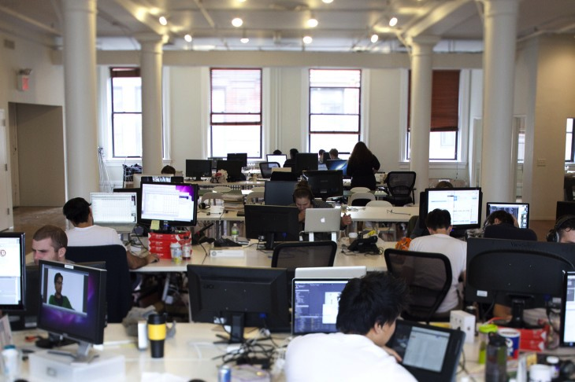
Workplace stress & fatigue
D/HH workers had:
Higher perceived effort to perform tasks
More fatigue
Higher stress hormone levels
(Jahncke & Halin 2012)
Notes:
For example, in a Swedish study adults with hearing loss performed basic memory and attention tasks in a simulated office with recordings of noise from an actual open-plan office. Compared with a matched group of adults without hearing loss, the DHH participants were more affected by noise. They reported more fatigue, and had higher stress hormone levels. Even people with mild to moderate hearing loss used significantly more effort in work-related tasks than the hearing control group. This confirms the load in terms of additional effort and stress many DHH workers face daily, and the physiological effects on them.

Slide 11
Examples of workplace accommodations
Furniture re-arranged | Better lighting
Real-time captioning | Amplified telephones
Sign language interpreters | Flashing alarms
Loop systems | Modified stethoscopes
Deaf awareness training | Wireless remote microphones/ devices
Notes:
To return to the sorts of adjustments and accommodations that people with hearing loss may need in the workplace, these are some, both informal and more formal that are commonly used. Many are simple and cost little or nothing, such as improving lighting or re-arranging furniture so that the person can see others better. Others may involve more cost, sometimes just an initial outlay for a piece of equipment. And thing such as interpreters and real-time captioning will be more costly.
Under Australian legislation (the Disability Discrimination Act 1992) employers are required to make reasonable adjustments, and there can be financial assistance provided.

Slide 12
Employment Assistance Fund
May fund:
Cost of modifications to the work environment
Adaptive equipment for the workplace
Information and communication devices
Auslan interpreting
Live captioning
Deafness awareness training
(jobaccess.gov.au)
Notes:
For example, the Employment Assistance Fund, a federal government initiative through Job Access, provides funds to people with disability or their employer for adjustments. These can be things such as adaptive equipment for the workplace, information and communication devices, Auslan interpreting, live captioning, and deafness awareness training to managers and co-workers.
This also applies to people who are self-employed.
Currently, up to $6000 per year can be used for interpreting or live captioning for meetings, etc. And the cost of an iPad for receiving captioning, and some assistive listening devices, may be claimed (although not hearing aids or cochlear implants).
This is the end of Part 3 of the presentation. The next and final part will cover postsecondary education.

