Slide 1


SUPpORTING adolescents who are deaf or hard of hearing IN Transition TO POST-SCHOOL EDUCATION & EMPLOYMENT
A narrated PowerPoint for careers personnel
September 2015
Part 1
Renée Punch PhD
Notes:
Welcome to this narrated PowerPoint, which is designed specifically for careers personnel in schools - anyone who works with students in career preparation and planning. It’s for both those personnel working in schools that have a unit or facility for students who are deaf or hard of hearing and for those in schools where there may only occasionally be a student with hearing loss.
Students who are deaf or hard of hearing are a diverse population. They may have any degree of permanent hearing loss, from mild to profound. Some students will use spoken language only to communicate, others will use sign language (Auslan) as well or predominantly.
Overall, this presentation is about how schools can support these young people to successfully transition to post-school employment and education and to have the best opportunities to reach their potential in their post-school life. It draws on recent international and Australian research, including my own research.

Slide 2
Part 1
Why focus on transition for D/HH students?
Hearing loss and adolescents
Transition best practices for students with disabilities
Part 2
A transition model for students who are D/HH
Self-advocacy and self-disclosure
Transition experiences of students who are D/HH
Part 3
Focus on employment
Part 4
Focus on postsecondary education
Summary of transition needs for D/HH students
Notes:
The presentation is divided into four parts, with each one about 15 minutes long. First, we’ll look at why we need to focus specifically on transition for students who are deaf or hard of hearing. And what some of the particular challenges are for these young people as they go through adolescence. After some general information about hearing loss and adolescence, I’ll discuss the evidence-based practices in transition for students with disabilities in general, and how these can guide best practice in transition with D/HH students.
In the second part I’ll present a model for transition planning and preparation for D/HH students, and talk about the self-advocacy skills and self-disclosure decisions that these students need to master. And a little about what we know of the experiences of D/HH students in their transition preparation and planning and what needs might remain for D/HH school-leavers.
Part 3 will focus on employment, and Part 4 on post-school education.

Slide 3
WHY is it so important to focus on transition for D/HH students?
Because D/HH people have:
Poorer education, employment, & income levels
Greater access to postsecondary education than in past, but
Lower retention and completion rates than general student population
Notes:
So why do we need to think specifically about transition for students with hearing loss? Well, first of all, while there are many DHH individuals who have achieved success in a wide variety of occupations and careers, DHH people continue to have higher rates of unemployment and underemployment and lower income levels than people without hearing loss. In recent years, especially the last 2 decades, there have been social, technological, and legislative changes that have improved opportunities for people with hearing loss. At the same time there have been changes in the labour market and the world of work. For example, the continuing trends towards greater mobility in the workforce and to more casual, freelance, and contract work mean people need a range of skills to manage their work-life, to seek new work and to promote themselves. This involves a range of communication abilities and skills that can be more challenging for DHH people.
Postsecondary graduation decreases employment and earnings gap between DHH people and the general population. And DHH students are entering university, and TAFE more than in the past. But, once there they are more at risk of non-completion of courses than students in general.

Slide 4
WHY is it so important to focus on transition for D/HH students? (cont.)
Because:
Barriers encountered can lead to disengagement, failure
Will need to advocate on their own behalf
May have experiential and conceptual knowledge gaps
Collaboration between teachers of the deaf and careers personnel essential
Notes:
Most people with hearing loss will encounter daily challenges and barriers, both environmental and attitudinal. Mostly, these are not insurmountable. But the obstacles encountered can cause D/HH young people to disengage, to fail, to chop and change trying to find right environment. I’ve seen this in many young people I’ve counselled a few years after they’ve left school.
Most will have been receiving specialised support in their primary and secondary schooling. Any supports or accommodations they’ve needed has come on the initiative of parents and educators. When they leave school, the responsibility shifts, and as young adults they need take initiative and an active role seeking out appropriate supports and accommodations. They will need to advocate on their own behalf once they leave school and it’s important that they have well-developed self-advocacy skills if they’re going to be successful.
Some of the within-person factors that can impede the post-school achievement of children who have a congenital hearing loss, or one that occurs in the first two to three years of life, are related to difficulties in developing certain skills and competencies. For instance, some D/HH school-leavers will have language and literacy skill deficits. They may have experiential and conceptual knowledge gaps. Some young people with hearing loss have less ideas about careers and the world of work because they’ve had limited access to the sort of incidental learning that happens through overhearing others’ conversation.
There is a need for specific transition planning and instruction that includes issues related to hearing loss. Transition and career programs for students without hearing loss are unlikely to be adequate in most cases. And collaboration between teachers of the deaf and schools’ careers personnel is essential to ensure that D/HH students receive transition and career guidance that includes deafness-related issues.

Slide 5
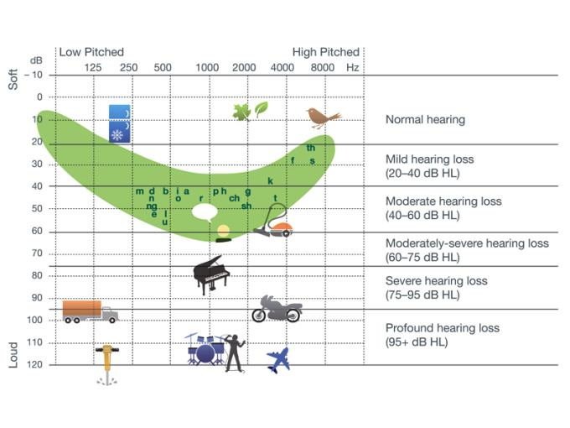
Hearing loss
Notes:
I’ll just talk briefly about hearing loss; This diagram shows both the loudness and frequency (pitch) of various everyday sounds. Going from top to bottom is increasing in volume and going from left to right is increasing in pitch. The diagram indicates the loudness and pitch of different sounds, and also shows where the different speech sounds lie. When hearing ability is measured, the quietest sounds that an individual can hear (hearing threshold) are plotted on an audiogram like this.
The different levels of hearing loss can be seen on the right hand side in the diagram. Sounds that lie above (quieter than) the hearing threshold cannot be heard by that individual person when not using a hearing aid.
It is important to remember that hearing aids make sounds louder for the child but they don’t restore normal hearing. Hearing aids make all sounds louder, including background noise. They work most effectively in quiet environments and at distances of one to two metres. Even with hearing aids, a child with moderate or severe hearing loss will usually need to rely on contextual clues and lip-reading. The level of concentration required to for this is difficult to maintain over long periods of time.
Specifically, people with hearing loss experience a loss of clarity of speech sounds, as well as loss of volume. They may miss subtle differences between similar words, they may be unable to separate speech from background noise, and they may unable to tell where a sound is coming from.

Slide 6
Students with cochlear implants
Children are still deaf and need specialised educational supports
Many people don’t realise that difficulties remain
Parents and young people concerned about post-school life
Limited exposure to D/HH role models
(Punch & Hyde, 2010, 2011)
Notes:
So young people will have varying levels of hearing loss, and someone with a mild hearing loss will face different challenges than someone with a profound loss. However, even mild hearing loss presents challenges and affects children’s educational and social development.
Today, the majority of infants and young children with severe to profound sensorineural hearing loss are having cochlear implants. In contrast to hearing aids, cochlear implants don’t amplify sounds. Rather they provide direct electrical stimulation to the hearing nerve. Hearing through a cochlear implant is different from normal hearing and takes time to learn.
Many children do very well with cochlear implants, particularly when implanted early, but outcomes are variable. Many will function more as hard of hearing, or like children with mild or moderate hearing loss. The cochlear implant doesn’t restore normal hearing, and children with implants continue to need specialised educational supports, including specialised transition supports. They are often in regular classes with support from visiting teachers.
In a large research study on children with cochlear implants in Australia that I was involved in a few years ago, visiting teachers reported that regular class teachers often don’t realise how much the children are not hearing in many settings, particularly group and social situations. And this was particularly the case of those children whose spoken language was good. Many parents we interviewed were concerned about their children’s future lives after leaving school. And these teenagers had limited exposure to D/HH role models, and often to other D/HH kids.

Slide 7
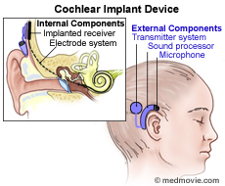
Notes:
Many people don’t realise that with people with cochlear implants have to wear external components. The internal part is implanted under the skin behind the ear, and then externally, there is a sound processor and coil that are worn behind the ear.
The person is completely without hearing when the external equipment malfunctions or needs to be removed, for example for sleep and some sports activities. In the Australian study I just mentioned, parents felt that their children were still deaf and some families valued the use of sign language, especially for when their children were without their external equipment.

Slide 8
Adolescence and hearing loss
A time of vulnerability in social and emotional wellbeing
Become more self-conscious about their deafness, hearing aids, cochlear implants, speech
Challenging communication environments - in groups, at parties, in noisy venues
Notes:
Adolescence can be a time of vulnerability in social and emotional wellbeing for young people with hearing loss. At a time when it’s incredibly important to feel accepted by your peers, to feel part of a group, teens with hearing loss often become more self-conscious about their difference, and their hearing aids or cochlear implants, and perhaps their voice or their speech. They are more aware than when they were younger that they mishear sometimes and maybe give a response that’s doesn’t fit, and that it’s hard being part of a group conversation. And the typical settings in which teens tend to socialise present communication challenges – such as parties, anywhere with loud music, and being in a large group.
So for adolescents, even when they have strong spoken language skills, the reality of everyday hearing difficulties can lead to feelings of isolation and not being fully part of the group.

Slide 9
Adolescence and hearing loss (cont.)
Identity formation
How does hearing loss fit in with identity?
May be:
Reluctant to wear hearing aids or use assistive devices
Reluctant to talk about it with adults
Notes:
As well, Identity formation is an important task in a young person’s development. If your peer group and your friends are all hearing, then that is how you want to see yourself, that is your idealised identity.
Because there is that fear of appearing different from peers, of not being cool, and their hearing aids or cochlear implants can seem to them like the visible sign of their ‘uncoolness,’ they may be reluctant to wear their hearing aids or use assistive devices. Teens have reported that they hate the questions they get about them, they don’t like the look of them, and they feel that other people react differently to them when they see their hearing aids or cochlear implants.
They are often also reluctant to talk about these matters with anyone, and yet a collaborative conversation with an adult who is prepared to listen and understand can have an important positive impact.
We shouldn’t underestimate the value of just having a conversation with a student, one that addresses these social and emotional factors.

Slide 10
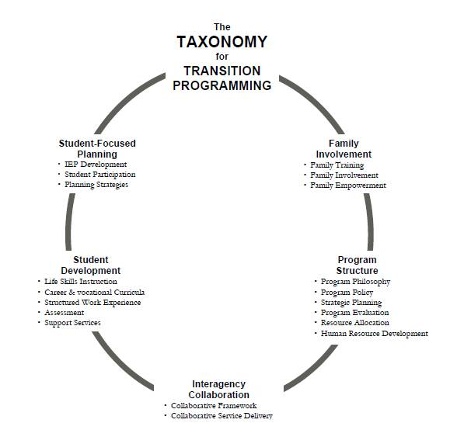
(Kohler, 1996)
Notes:
In considering how young people with hearing loss can be best prepared for the post-school challenges they’re likely to face, it’s helpful to draw on what’s been found to be effective in supporting the transition from school for students with disabilities in general. In last few decades there’s been a lot of research into the in-school practices that contribute to the successful transition of students with disabilities, and the findings are largely consistent with a model, or taxonomy, of transition practices developed by Paula Kohler in the 1990s. This taxonomy is now endorsed as the gold standard for transition.
The categories of transition practices that have been found to be most important come under five areas. The first is student-focused planning, in which the student with a disability is actively involved in setting post-school goals and evaluating their progress towards meeting those goals
The second is student development, and I’ll come back to that in a moment. The third is Family involvement -the education, empowerment, and involvement of families in the transition process is a key practice for improving the post-school outcomes for of a student with a disability.
Interagency collaboration refers to links with agencies and local employers to establish work experience placements, and with agencies offering employment services, and with disability offices in universities and colleges.
And finally, program structure has to do with the policy and planning level, resource allocation and human resource development in transition. I’m going to talk a bit more about student development, because that is an area that is particularly important.

Slide 11
Student development
Employment skills instruction
Structured work experience
Career and vocational curricula
Transition assessment – formal & informal
Self-determination training
Notes:
Student development covers a number of areas in which the student with a disability needs to have experience or instruction. All of these are associated with positive post-school outcomes.
And self-determination is increasingly being seen as critical to successful post-school outcomes of students with and without disabilities.
.

Slide 12
Self-determination
“a combination of skills, knowledge, and beliefs that enable a person to engage in goal-directed, self-regulated, autonomous behaviour”
Developmental, but not automatic
Notes:
Self-determination is defined as a combination of skills, knowledge, and beliefs that enable a person to engage in goal-directed, self-regulated, autonomous behaviour.
Becoming self-determined is a developmental task, but it’s not considered automatic – intentional intervention efforts may be needed. There are a number of classroom-based instructional packages in Self-Determination; ideally it’s infused into general curriculum.

Slide 13

Self-determination skills
Goal-setting and planning
Problem-solving
Decision-making
Communication
Assertiveness
Self-awareness
Self-advocacy
Notes:
Self-determination involves skills and behaviours including goal-setting, decision-making, problem-solving, assertiveness, self-awareness, and self-advocacy. Self-awareness involves an accurate self-appraisal of strengths, abilities, support needs, and responsibilities. For young people who are D/HH, the skills of self-determination and self-advocacy, including when and how to disclose their hearing loss and to request accommodations, are of major importance, and I’ll talk more about them next, in Part 2 of the presentation.

